Slide 1



Slide 1
Neural Network Models for Object Recognition
Group 3
Notes:
Welcome to our presentation. In the presentation, we are going to discuss Neural Network Models for Object Recognition.

Slide 2
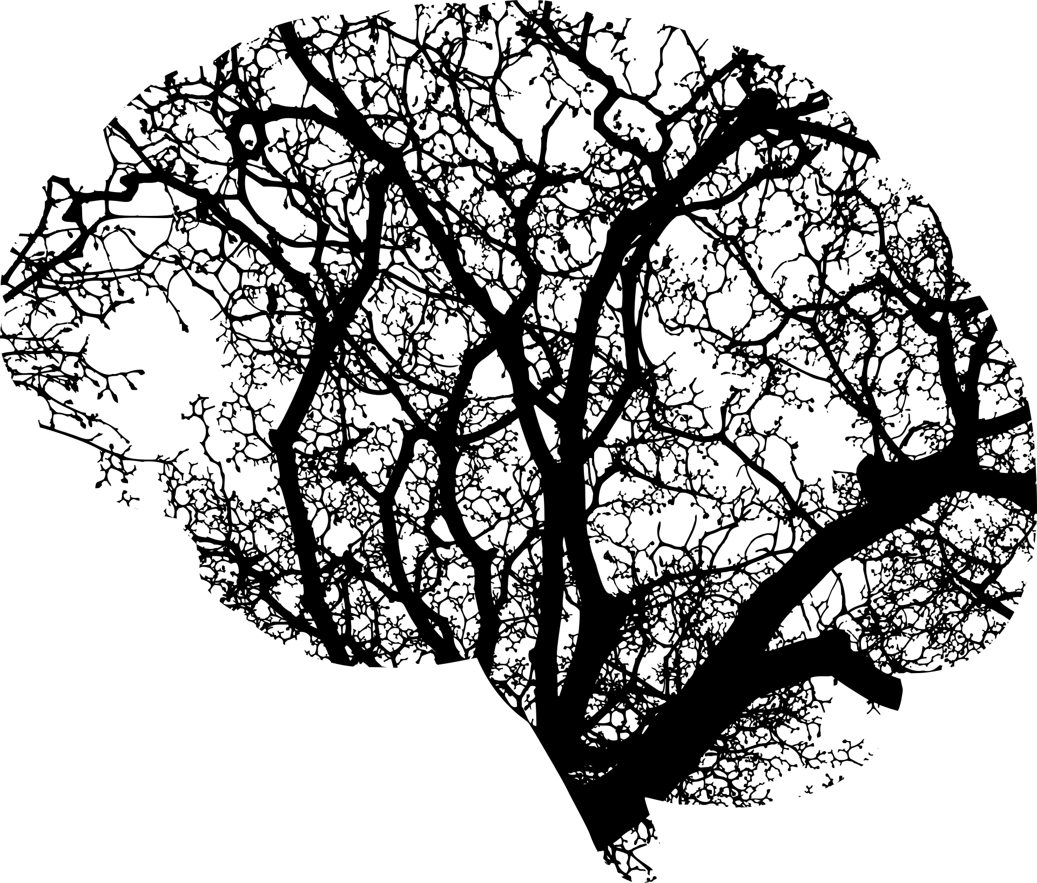
Slide 2
OVERVIEW
Artificial Neural Networks (ANN) imitate the neuron system, connecting nodes of the neuron, processed by the activation function, to make a final decision based on the calculation between weights multiplied by input value plus the bias (Géron, 2019) .
Notes:
Object recognition has already been a research topic for years. Object recognition or object detection is part of the research in computer vision, deep learning area, or in artificial intelligence (Deng et al, 2020). There is multiples method used for object recognition, one of them is Artificial Neural Networks (ANN). ANN imitates the neuron system in the human brain, which is connected to around 86 million neuron networks in the human brain (Herculano-Houzel, 2012). Similar to the human brain, each node is connected with the other node, then the activation function calculates the probability based on the weight and input value to find the closest decision (Géron, 2019).

Slide 3
Slide 7
INTRODUCTION
Background
Purpose
Methodology
How machine learning can identify the object.
Artificial Neural Networks (ANN) is the tool which imitate human brain for the machine to learn.
Neural networks divided into three main parts, input, multiple hidden layer, and output (Dertat, 2017).
Explain on what is the ANN
Experiment ANN with CIFAR-10 data (Krizhevsky, 2017)
Evaluate the method
Use keras library to process the object recognition
Load CIFAR-10 Data
Divide data as train and test data
Train data using ANN method
Check accuracy
Notes:
The presentation will discuss how machine learning can identify the object. The method selected in this presentation is using Artificial Neural Networks (ANN). Artificial neural networks are divided into three main parts, input layer, multiple hidden layers, and output layers (Dertat, 2017). Input layer act as the recipient of the object and it has value. Hidden layer act as the activation function to calculate based on the input value multiplied by the weight of each node. The output layer is the layer where it has the value resulting from the activation function.
The presentation will explain in detail what is ANN and how it works on object recognition. The experiment is using CIFAR-10 data, a collection of 60,000 images with the size of 32x32 classified into 10 classifications, where each has 6,000 images (Krizhevsky, 2017). The Keras library has its own library to load the dataset of CIFAR-10 directly. The dataset is divided into train data and test data. Train data will consist of 50,000 images, and test data will consist of 10,000 images. Train results will be evaluated against the test data, to get the accuracy of the model.

Slide 4
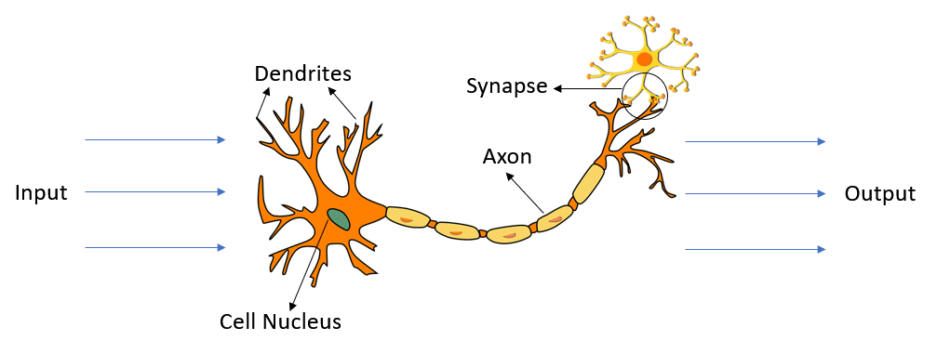
Slide 7
NEURONS
How does it work?
Input signals received by dendrites
The input processed and transform the information inside the body cells
The input transferred thru axon and send the output into the synapsis
Output signal send thru axon terminals
Image from pixabay.com
Notes:
Before we explain the ANN, first we will discuss how the neuron works. Neurons consist of dendrites, cell nuclei, body cells, axons, and synapses. In the image, the orange part near the cell nucleus is the body cell. The input signal is received by the dendrites. Dendrites may receive the input signal from the previous neuron system. Body cells will process all input information and transfer it thru the axon. The synapse is the link between one neuron to another neuron. In the synapse, the processing output will be transferred as the result. As explained earlier, the neuron systems in the human brain comprise 86 millions neuron. The beauty of the human brain, in these large numbers of neuron networks, the information can be processed and transferred in a very short time (Herculano-Houzel, 2012).

Slide 5
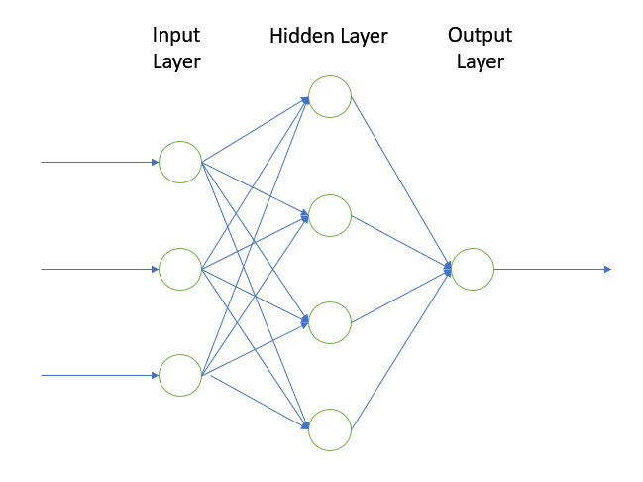
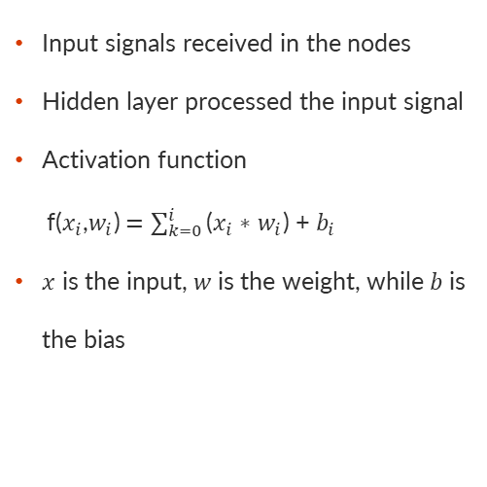
Slide 7
ARTIFICIAL NEURAL NETWORKS
How does ANN work?
Input signals received in the nodes
Hidden layer processed the input signal
Activation function
f($x_{i}$,$w_{i}$) $=\sum_{k=0}^{i}{\text{(}x_{i}\text{ ∗ }w_{i}\text{) + }b_{i}}$
$x$ is the input, $w$is the weight, while $b$is the bias
Notes:
Imitating the neuron systems in the human brain, researchers found a method called Artificial Neural Networks. How it works is very similar to what the human brain does. Input information received by the nodes. The input is transferred into one or multiple hidden layers. As seen in the image, three inputs passed into the nodes and transferred into four nodes in the hidden layer. Each node has weight and is calculated in the activation function. The activation function is the sum of the multiplication of the input value, multiply by the weight plus the bias.

Slide 6
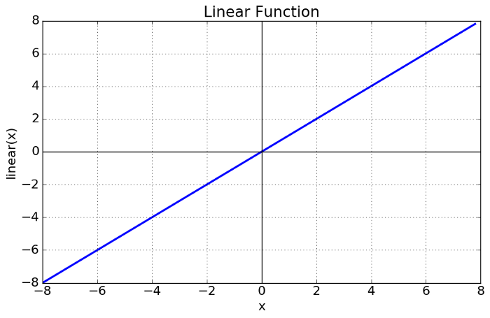
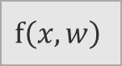
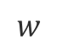

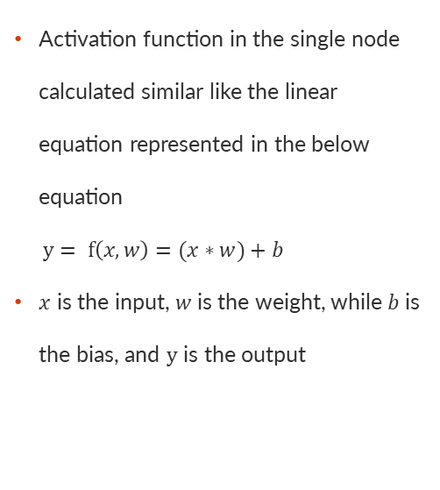
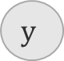

Slide 7
ARTIFICIAL NEURAL NETWORKS
Linear Activation Function
$$x$$
$$w$$
$$f\left(x,w\right)$$
$$y$$
Activation function in the single node calculated similar like the linear equation represented in the below equation
$y= f\left(x,w\right)=(x∗w)+b$
$x$ is the input, $w$is the weight, while $b$is the bias, and $y$ is the output
$$b$$
Fig. Linear Activation Function (Nadeem, 2022)
Fig. Linear Function (Image Source: Sharma, 2022)
Notes:
The activation function for a single node can be represented in a linear equation:
$y= f\left(x,w\right)=\left(x∗w\right)+b$
where $x$ is the input, $w$is the weight, while $b$is the bias, and $y$ is the output (Nadeem, 2022).

Slide 7
Slide 7
ACTIVATION FUNCTION
What is activation function
Types of Activation
The main functionality of activation function is to processed input signal into output
Linear activation function
Non-linear activation function
Notes:
The activation function or known as the transfer function is used to process the input signal into the output signal of the node (Sharma, 2022). There are two types of activation functions, they are linear activation functions and non-linear activation functions. A linear function has the linearity of the result depending on the value of the input. It could range from minus infinite to plus infinite. Non-linearity function, easier to adapt with the input condition. The non-linear activation function is divided into the sigmoid function, tanh function, rectified linear unit (Relu), and Leaky Relu.

Slide 8

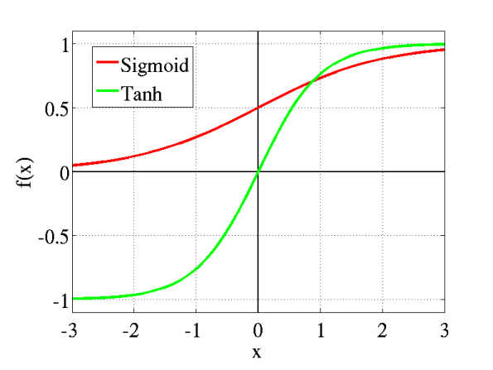
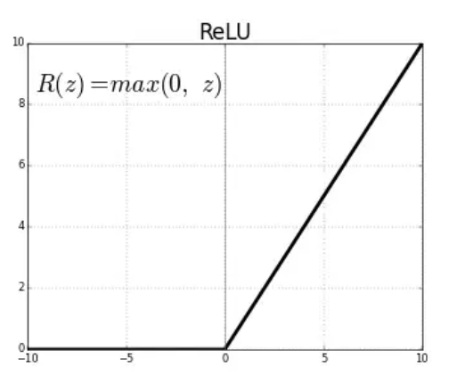
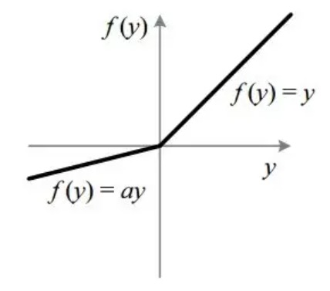
Slide 7
ARTIFICIAL NEURAL NETWORKS
Non-Linear Activation Function
Non-Linear Activation function has few types such as Sigmoid, Tanh, Rectified Linear Unit, or Leaky Relu
Sigmoid Function
Tanh Function
Relu
Leaky Relu
Image Source: Sharma, 2022
Notes:
As already mentioned earlier, the non-Linear Activation function has a few types such as Sigmoid, Tanh, Rectified Linear Unit (Relu), or Leaky Relu. The sigmoid function has ranged between 0 and 1. The sigmoid function has the capability to predict the probability where if the value is close to 1, the result is most likely true, and if the value result close to 0, the result is most likely false. One of the most used sigmoid functions is softmax, used to classify multiple classes (Sharma, 2022). Unlike the sigmoid function, the Tanh function or called as hyperbolic tangent activation function has a range between -1 and 1. Similar to the sigmoid function, both Tanh and sigmoid is s-shaped function. Tanh activation function is good for comparison between two classifications (Sharma, 2022).
Nowadays, Rectify Linear Unit (Relu) become the most popular activation function used in the world. The range of this activation function is between 0 and infinite. Any negative value in the Relu is changed to 0 immediately. If the function is above zero, then the result is also above zero. The downfall of this method is for any minus result, is changed to zero immediately, which reduces the ability to fit the result during the training. This downfall was tried to fix by the Leaky Relu activation function method. There is an additional constants value “a”, where normally the “a” value is 0.01. It is increasing the range to fit the result during training. The range result will be minus infinite and plus infinite (Sharma, 2022).

Slide 9
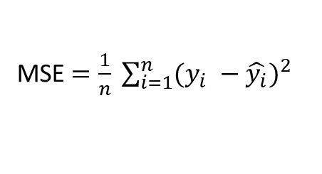
Slide 7
ARTIFICIAL NEURAL NETWORKS
Loss Function
Mean Squared Error
Loss function is used to see how well the predicted result against the target value (Yathish, 2022).
There are few types of loss function, such as cross-entropy, binary cross-entropy, categorical cross-entropy, sparse categorical cross-entropy, or mean squared error.
One of the most popular lost function is Mean Squared Error
Predicted and expected value should be real number
Calculate the difference between predicted and target value, then squared it.
The cost will be calculated as the average.
MSE $=\frac{1}{n} \sum_{i=1}^{n}{{(y_{i} −\hat{y_{i}})}^{2}}$
Notes:
The loss function is used to see how well the predicted result is against the target value (Yathish, 2022). There are a few types of the loss functions, such as cross-entropy, binary cross-entropy, categorical cross-entropy, sparse categorical cross-entropy, or mean squared error.
One of the most popular lost functions is Mean Squared Error (Seb, 2022). Mean Squared Error only allows predicted and expected values to be real numbers (Yathish, 2022). The total difference between the predicted and the target value is squared. The total differences are calculated as the average of the total error cost (Seb, 2022).

Slide 10
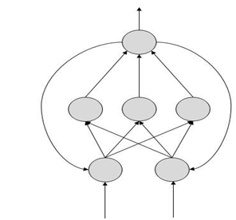
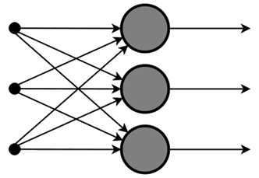
Slide 7
TYPES OF ARTIFICIAL NEURAL NETWORKS
Types of ANN
Feed forward ANN
Feedback ANN
Feed Forward ANN (Image Source: Ali, 2019)
Feedback ANN (Image Source: Ali, 2019)
Notes:
There are two types of Artificial Neural Networks. Feedforward ANN and feedback ANN. Feed-forward ANN only transfers the information into nodes and passes it as the output. Unlike feed-forward ANN, feedback ANN allows feedback from the output back to the initial nodes (Ali, 2019). Feedforward ANN, only processes in one direction. And it is the simplest form of neural network.
Now my fellow student Bharadwaj will explain how a neural network is implemented.

Slide 11
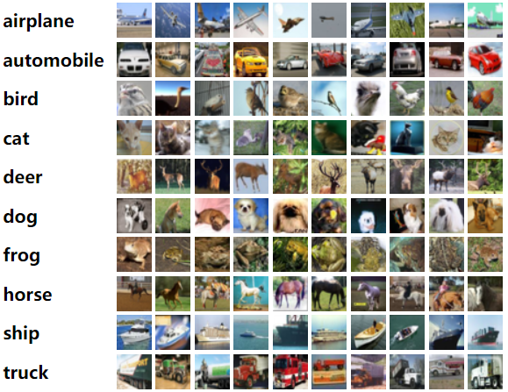
Slide 7
CIFAR-10 DATA
CIFAR-10
Collection of images used to train a machine learning
Classify into 10 categories, which contains 60,000 images.
CIFAR-10 images classified as airplane, automobile, bird, cat, deer, dog, frog, horse, ship, and truck
Notes:
Thank you, Indra. I will take it from here now. CIFAR 10 is a dataset that primarily consists of images of 10 different categories/classes that are used in building machine learning models. There are classes like airplanes, horses, cats, deer, and so on. The dataset comprises of 60,000 images using which we performed machine learning techniques like ANN, and CNN, respectively. Further in this presentation, we shall see how we have used the data to train, validate and test the data on ANN and CNN.

Slide 12
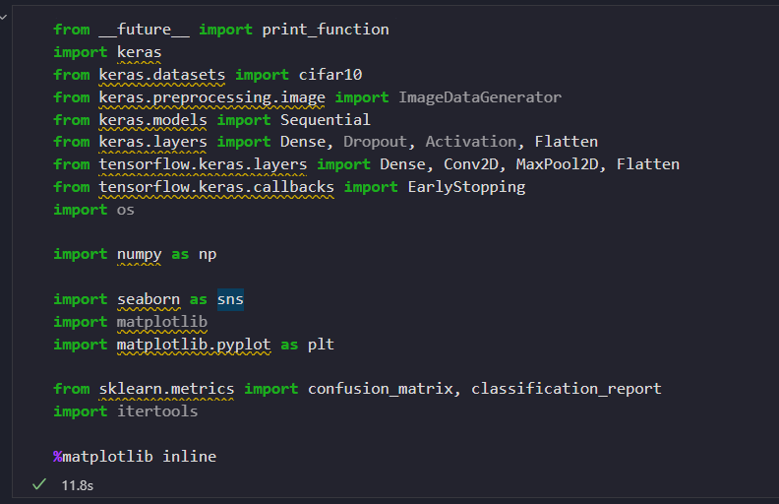
Slide 7
IMPLEMENTATION
LIBRARIES
The main library used is Keras.
Keras is a library for deep learning which run on top of tensorflow (Keras, nd).
Notes:
The first and foremost step is to import all the required python libraries and the CIFAR 10 dataset into our python Integrated Development Environment (IDE). The image shows the same. The predominant library among all is Keras and its subclasses. Once we have imported all the requirements, we move on to the next step, which is, data preprocessing.

Slide 13
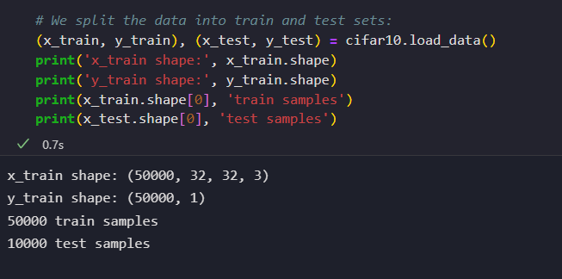
Slide 7
IMPLEMENTATION
LOAD CIFAR-10 DATA
The data loaded using keras.dataset library into train and test set
Train data contains 50,000 records with 32 x 32 size,
Test data contains 10,000 records
Notes:
After loading the dataset, we begin the data preprocessing step, firstly, by splitting the dataset into train and test sets, respectively. From the image, The shape of the train set implies that the training set has 50,000 images of 32 height by 32 width with a 3-color scheme. The target variable y has 50,000 records containing the names of the classes. The test samples are shown as 10,000 which will be used for testing our neural network model.

Slide 14
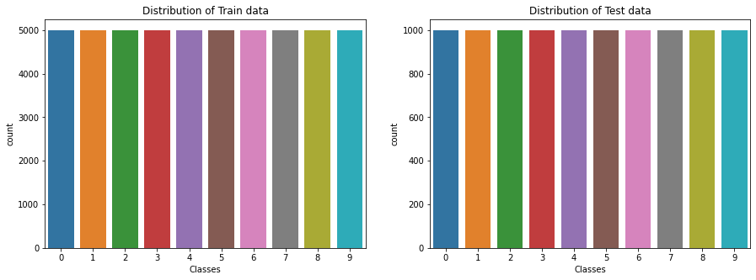
Slide 7
IMPLEMENTATION
DATA PRE-PROCESSING
Train and test data classified into 10 classes each
The distribution of each class of train data is 5,000 for each class
The distribution of each class of test data is 1,000 for each class
Notes:
Furthermore, we check the distribution of each class in both train and test sets so as to avoid any imbalances in the classes. We can deduce by the graph that there is an equal amount of data in the train and test sets for all the 10 classes. In the coming slides, we are going to perform more data preprocessing tasks and eventually get to the model building.

Slide 15
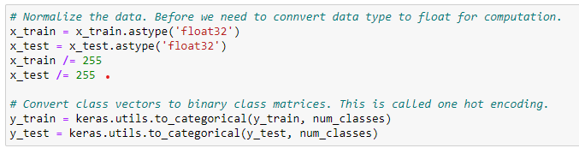
Slide 7
IMPLEMENTATION
NORMALISATION
Train and test data normalized into float data type
The target variables are also converted into vectors by one hot encoding process
Normalization ensures similarity of data across all dimensions.
Notes:
The next step in our process is to normalize the data and start building the neural net. The purpose of normalization is to ensure similarity of data across all records. This is done by converting the train and test samples into float data types and then dividing by 255 (owing to the grayscale 0-255) to make the model building even simpler. The target variable is also converted into a vector for both train and test samples. This process is called one hot encoding.

Slide 16
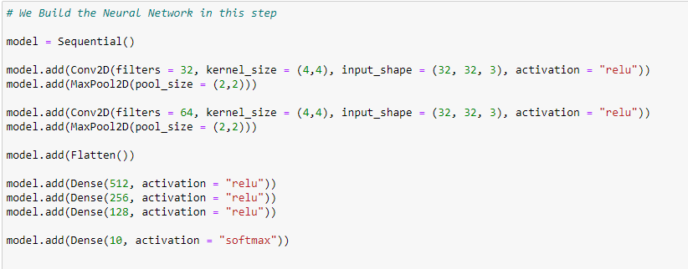
Slide 7
IMPLEMENTATION
BUILDING NEURAL NETWORK
The neural network is built using convolution, pooling, flatten and dense layers.
The bigger the neural network, the faster is the compiling time and the better are the results.
The layers were limited to avoid overfitting of the data.
Notes:
We now start building the neural net. Our neural network consists of 9 layers out of which 2 are convolution layers, 2 are pooling layers, one flattening layer and 4 dense layers, thereby completing the neural network.
A convolution layer is the building block of a neural network. It contains a set of filters and parameters that are to be learned to gauge the neural network’s performance. These filters are smaller in size than the image, which convolves with the image and produces an activation map. Then by iteration of the parameters, the activation map gets precise.
A max-pooling layer is similar to a convolution layer; instead, the layer does not do a product between the image and the filter used but determines the maximum value in the region overlapped by the kernel on the image (Patel, 2019). The layer then strides across the whole image by doing so and generates an activation map. This layer helps in reducing overfitting of the data.
After obtaining the pooled layer, we then flatten the activation map by passing it through the flatten layer of the network. The flatten layer converts the feature map, which is basically a matrix into a vector. This ensures faster processing of the data. ( SuperDataScience, 2018).
Finally, we pass out outputs from all previous layers to the dense layers, which are used to classify the outputs from previous layers. It uses a nonlinear function called the activation function and classifies the output. The result of the dense layer is generally considered as the final output of the neural network (Dumane, 2020).

Slide 17
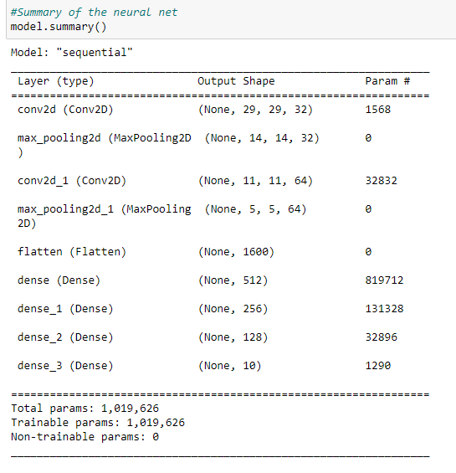
Slide 7
IMPLEMENTATION
SUMMARIZING THE NEURAL NETWORK
After building the network, we then observe how the neural net looks.
The image summarizes the network perfectly.
There are about a million trainable and no non-trainable parameters in the network.
Notes:
After building the neural network, we can look at the same by using the summary command. This is how the summary of the neural network looks like. It gives us brisk information about the layers used, the number of trainable and non trainable parameters.

Slide 18
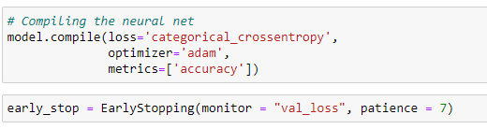
Slide 7
IMPLEMENTATION
COMPILING THE NEURAL NETWORK
After building and summarizing the network, we then move on to compile the neural net, which is the one last step before training the model.
We use the ‘adam’ optimizer and the ‘cross_entropy’ parameter to monitor the model’s performance and check the ‘val_loss’ parameter to ensure decent model performance.
Notes:
After building the neural net, we move on to compile the neural network using certain input parameters. Optimizers are algorithms used to monitor the network's weights and other parameters to reduce the loss incurred in the model (Kumar, 2020). Once the required parameters are set, we move on to training the neural net with those input parameters and of course, our data.

Slide 19
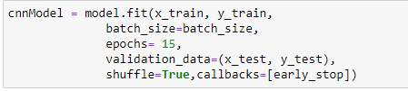
Slide 7
IMPLEMENTATION
TRAINING THE NEURAL NETWORK
This is the step where we train our neural network with the training set of the CIFAR10 data.
The image shoes the code required to do so.
Notes:
We now train our neural network using the training set of the CIFAR10 data and observe how it does. model.fit is the command generally used to train any neural network with the input parameters as shown in the image.

Slide 20
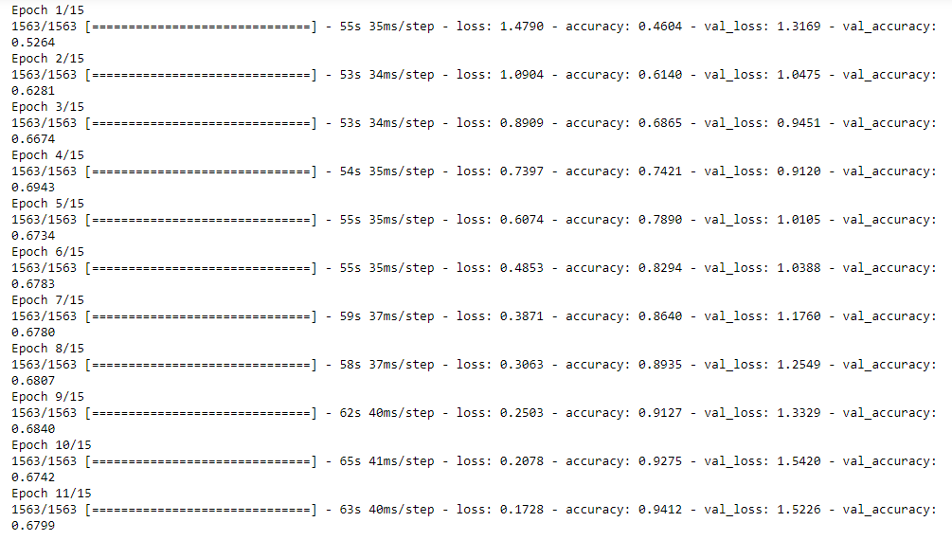
Slide 7
IMPLEMENTATION
HOW THE NEURAL NET PERFORMS
The model’s performance on the train data set is observed.
The time taken for each iteration (epoch) is about 1 minute, on an average. This varies based on the system specifications.
Bigger the computer, faster is the training time.
Notes:
This is how the neural network performs on the training set of the CIFAR10 data. The model's accuracy gradually increases while the loss gradually decreases. The key thing in the compilation is the val_accuracy parameter which is about 0.6799 ~ 68% when rounded off.

Slide 21
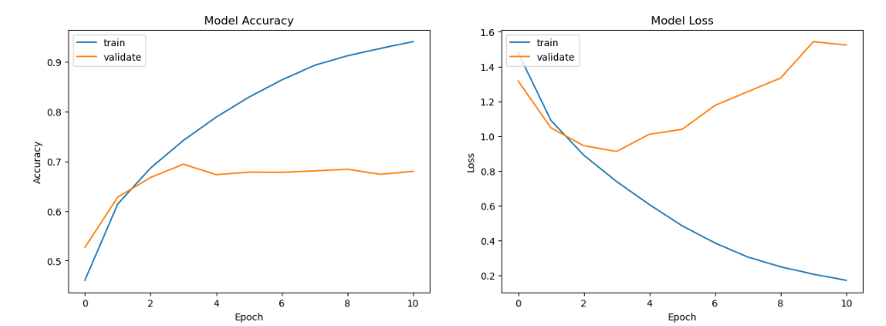
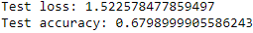
Slide 7
RESULTS AND TESTING
GRAPHICAL REPRESENTATION OF THE MODEL PERFORMANCE
TESTING MODEL USING TEST DATASET
As explained, the loss decreases as the accuracy goes up with each iteration.
The model is now tested with the test data of the CIFAR10 data.
It has a score of 68% .
Notes:
The graphs show how has the model progressed over each iteration. The left graph is the model’s accuracy. With each increasing iteration, the training accuracy ( blue line) has steadily risen. The validation accuracy has however peaked after the 5th epoch, which is about 68%, as seen earlier. The test scores are also like the validation accuracy which, in our case, is good. The loss graph shows how the loss has decreased with each iteration. The validation loss has not been consistent, but a decreasing trend could be observed. This happened because we had limited the number of iterations for reasons like avoiding overfitting, saving time, etc.

Slide 22
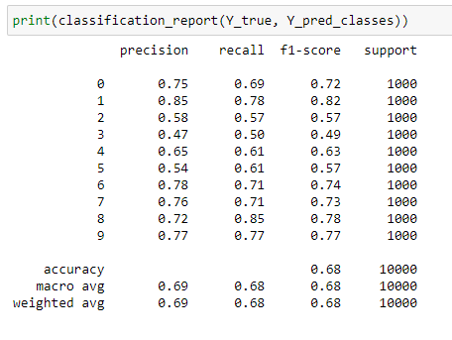
Slide 7
RESULTS AND TESTING
GENERATING THE CLASSIFICATION REPORT FOR ALL CLASSES
Classification report gives the summary of important metrics like f1 score, precision, recall, etc. for all the classes in the CIFAR10 data.
Notes:
This is how we generate the metrics for each class in the CIFAR10 data. The classification_report command is used to generate it. It gives metrics that are calculated using the confusion matrix like precision, recall, etc. Without the hassle of calculation as the matrix would be of 10x10 size. By observing the table, class 1 has the highest scores of all.

Slide 23
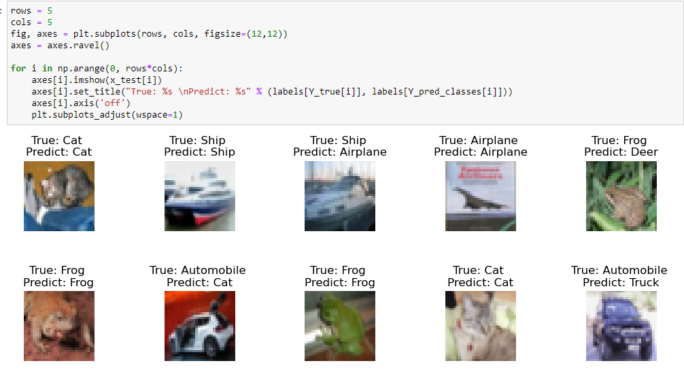
Slide 7
RESULTS AND TESTING
VERIFYING THE PREDICTIONS – RIGHT, WRONG AND EXTREMELY WRONG
We physically verify the correct, wrong and extremely wrong predictions made by our model.
The interesting factor is the extremely wrong predictions.
Notes:
We have verified whether our model has made correct predictions for the testing data or not These images here show the greatest number of correct predictions (6/10) like the cat, frog, the airplane and the ship. The subsequent slides show the wrong and extremely wrong predictions made by the neural net.

Slide 24
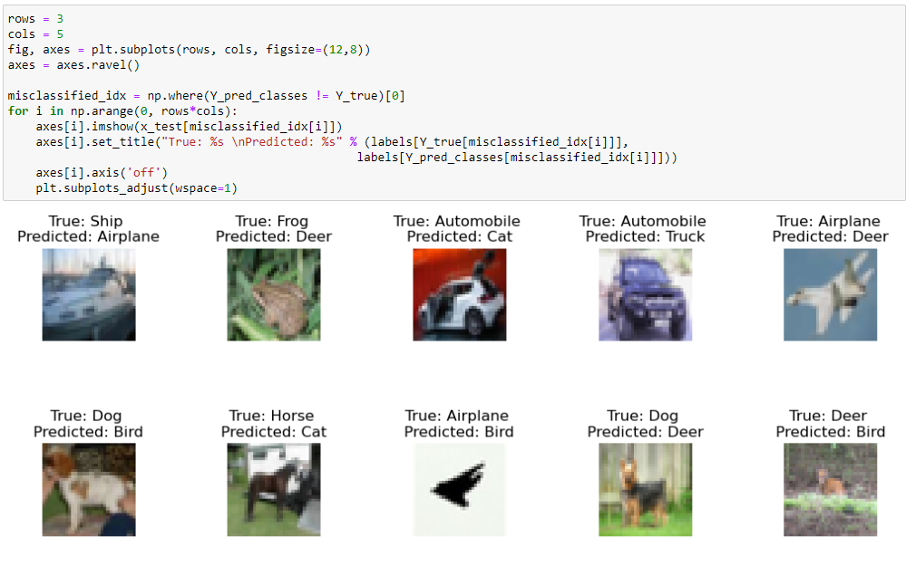
Slide 7
RESULTS AND TESTING
VERIFYING THE PREDICTIONS – RIGHT, WRONG AND EXTREMELY WRONG (CONT’D)
We physically verify the correct, wrong and extremely wrong predictions made by our model.
The interesting factor is the extremely wrong predictions.
Notes:
This slide highlights the wrong predictions made by the neural net. In these predictions, the model was able to recognize the image partially but, in the end, the classification was made wrongly. For instance, the horse-cat classification, the model recognized that the image had 4 legs, just like horses and cats do, but made the wrong prediction as a cat where in the true image was of a horse. The next slides highlights the most wrong predictions made by the neural net.

Slide 25
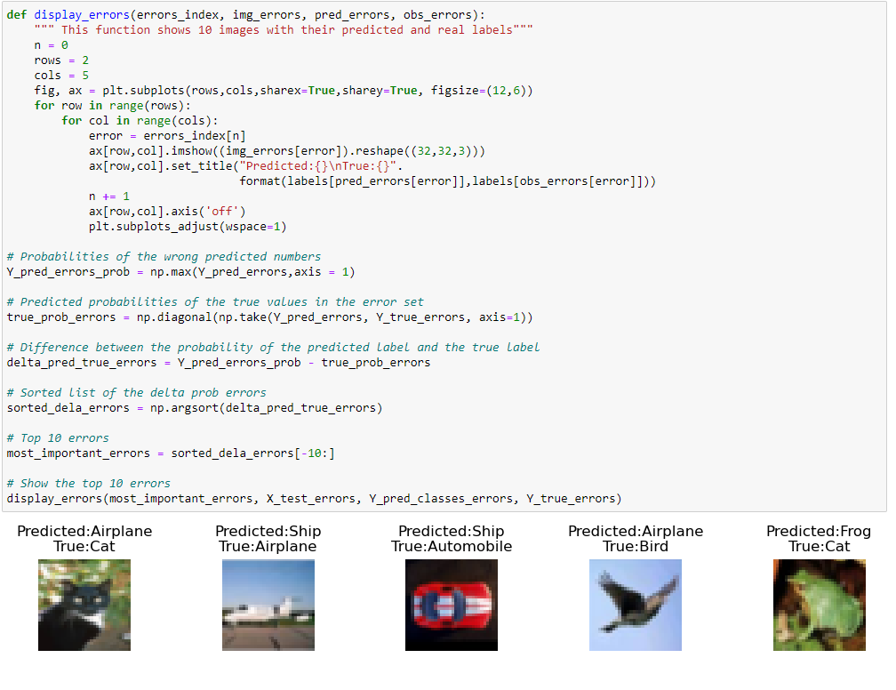
Slide 7
RESULTS AND TESTING
VERIFYING THE PREDICTIONS – RIGHT, WRONG AND EXTREMELY WRONG (CONT’D)
We physically verify the correct, wrong and extremely wrong predictions made by our model.
The interesting factor is the extremely wrong predictions.
Notes:
This is where the neural net has failed to recognize an image correctly and classify it. This could have happened because the number of layers in our network were less which gives no room for the model to analyze all images correctly, train the model on the data and classify the images. Also, poor labelling of input images must have impacted the model's prediction capability (franky, 2021).

Slide 26
Slide 15
THANK YOU!

Slide 27
Slide 12
References
Ali, A. (2019) Artificial Neural Network (ANN), Medium. Wavy AI Research Foundation. Available at: https://medium.com/machine-learning-researcher/artificial-neural-network-ann-4481fa33d85a (Accessed: November 29, 2022).
Deng, J. et al. (2020) A review of research on object detection based on Deep Learning, Journal of Physics: Conference Series, 1684(1), p. 012028. Available at: https://doi.org/10.1088/1742-6596/1684/1/012028.
Dertat, A. (2017) Applied deep learning - part 1: Artificial Neural Networks, Medium. Towards Data Science. Available at: https://towardsdatascience.com/applied-deep-learning-part-1-artificial-neural-networks-d7834f67a4f6 (Accessed: December 4, 2022).
Dumane, G. (2020) Introduction to convolutional neural network (CNN) using tensorflow, Medium. Towards Data Science. Available at: https://towardsdatascience.com/introduction-to-convolutional-neural-network-cnn-de73f69c5b83#:~:text=Dense%20Layer%20is%20used%20to,on%20output%20from%20convolutional%20layers.&text=Each%20Layer%20in%20the%20Neural,as%20an%20%E2%80%9Cactivation%20function%E2%80%9D. (Accessed: December 4, 2022).

Slide 28
Slide 12
References
Gallant, S.I. (1990) Perceptron-based learning algorithms. IEEE Transactions on neural networks, 1(2), pp.179-191.
Géron, A. (2019) Hands-on machine learning with scikit-learn and tensorflow concepts, tools, and techniques to build Intelligent Systems. Beijing: O'Reilly.
Herculano-Houzel, S. (2012) “The remarkable, yet not extraordinary, human brain as a scaled-up primate brain and its associated cost,” Proceedings of the National Academy of Sciences, 109(supplement_1), pp. 10661–10668. Available at: https://doi.org/10.1073/pnas.1201895109.
Keras. (nd) Keras documentation: About keras, Keras. Available at: https://keras.io/about/ (Accessed: December 3, 2022).
Krizhevsky, A. (2017) CIFAR-10 and CIFAR-100 datasets. Available at: https://www.cs.toronto.edu/~kriz/cifar.html (Accessed: December 4, 2022).

Slide 29
Slide 12
References
Kubat, M. (2021) An introduction to machine learning. Cham: Springer.
Kumar, S. (2020) Overview of various optimizers in Neural Networks, Medium. Towards Data Science. Available at: https://towardsdatascience.com/overview-of-various-optimizers-in-neural-networks-17c1be2df6d5#:~:text=Optimizers%20are%20algorithms%20or%20methods,problems%20by%20minimizing%20the%20function. (Accessed: December 4, 2022).
Nadeem, Q. (2022) Seminar ANN. University of Essex Online.
Patel, K. (2020) Convolution neural networks - A beginner's guide [implementing a mnist hand-written digit..., Medium. Towards Data Science. Available at: https://towardsdatascience.com/convolution-neural-networks-a-beginners-guide-implementing-a-mnist-hand-written-digit-8aa60330d022#:~:text=Max%20Pooling%20Layer&text=It%20is%20similar%20to%20the,2%20and%20stride%20of%201. (Accessed: December 4, 2022).
Seb (2022) An introduction to neural network loss functions, An Introduction to Neural Network Loss Functions. Available at: https://programmathically.com/an-introduction-to-neural-network-loss-functions/ (Accessed: December 4, 2022).

Slide 30
Slide 12
References
Sharma, S. (2022) Activation functions in neural networks, Medium. Towards Data Science. Available at: https://towardsdatascience.com/activation-functions-neural-networks-1cbd9f8d91d6 (Accessed: December 4, 2022).
Team, S.D.S. (2018) “Convolutional Neural Networks (CNN): Step 3 - Flattening,” SuperDataScience, 18 August. Available at: https://www.superdatascience.com/blogs/convolutional-neural-networks-cnn-step-3-flattening (Accessed: December 4, 2022).
Yathish, V. (2022) Loss functions and their use in neural networks, Medium. Towards Data Science. Available at: https://towardsdatascience.com/loss-functions-and-their-use-in-neural-networks-a470e703f1e9#:~:text=A%20loss%20function%20is%20a,the%20predicted%20and%20target%20outputs. (Accessed: December 4, 2022).

